Slide 1





Start your journey with us.

Slide 2
Our Story
Dollar Rent A Car is a global car hire company owned by DTAG Inc., headquartered in Tulsa, Oklahoma, USA. Dollar has operations in over 640 worldwide locations covering 53 countries, with a fleet of approximately 200,000 vehicles. Dollar in the UAE is a franchised operation owned by the prestigious A.A. Al Moosa Enterprises. Dollar UAE commenced its operations in 2004 and is currently operating across the cities of Dubai, Abu Dhabi, and Sharjah. Dollar UAE currently has 26 locations across the UAE and has the widest range of vehicles to choose your car rental. Today it is one of the leading car rental companies in the country.
A.A. Al Moosa Enterprises was established by Mr. Abdullah Ahmed Al Moosa as an Architectural and Engineering firm, has since grown into an Enterprise with business interests in Architecture & Engineering Consultancy, Interior design, Real Estate, Hotels, Furniture, Manufacturing of mattress and Car Rental Services

Slide 3
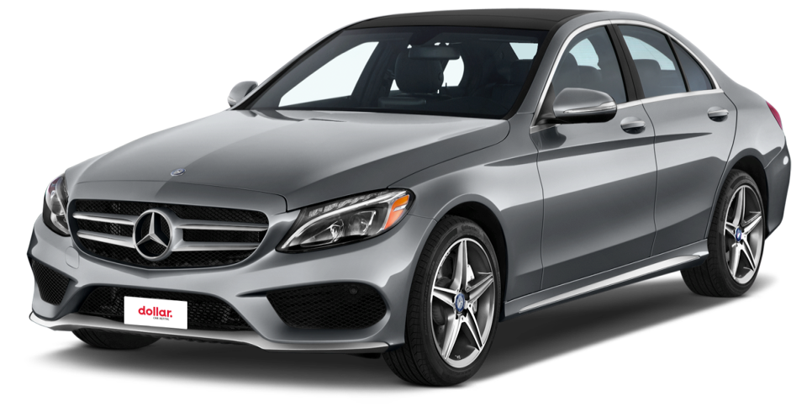
Why We EXIST
Vision
Mission
Core Values
Our vision is to become a customer centric company with focus on creating a consistent and sustainable business growth.
Our mission is to provide a hassle free renting experience to our customers through constant innovation and consistent delivery of quality products and a great customer experience.
Committed to give customer a delightful renting experience
Keep it easy and simple
Integrity
Innovative
Honesty

Slide 4
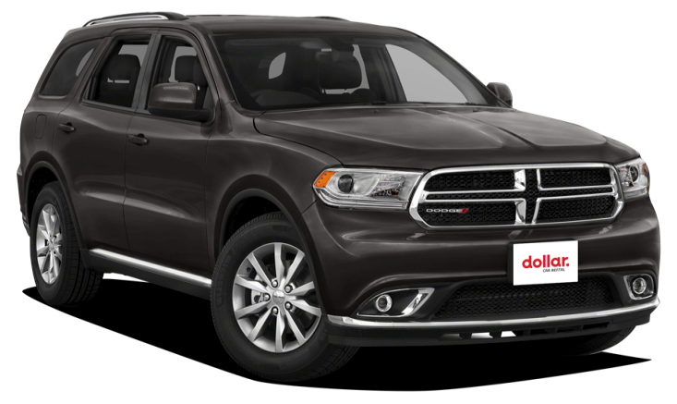
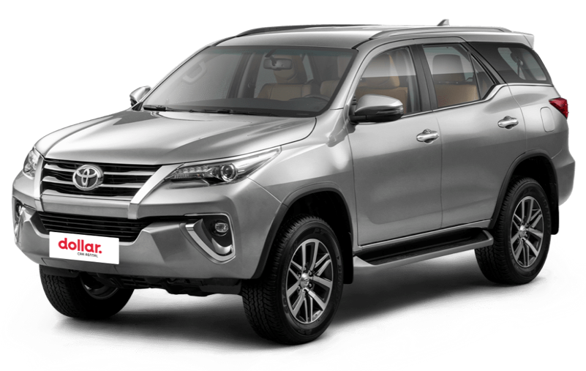
We strive for your convenience
Daily, Weekly and Monthly Rentals
Long Term & Personal Lease
Online Reservations
24/7 Airport Services
Commercial & Specialized Fleet
Delivery & Collection Services
More Convenience • Mini lease (6 months)
• Baby Seats & GPS Rentals
• Airport / Hotel Pickup & Drop Off
• Mobile Wi-Fi Services Available

Slide 5
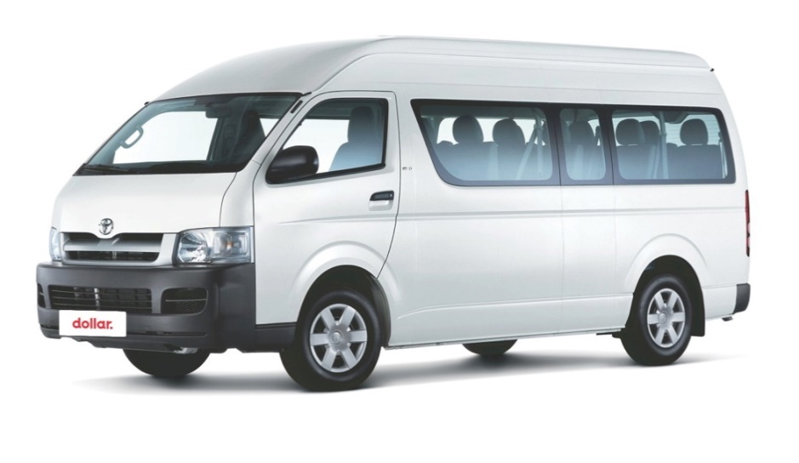
Total Transportation Solution
A diversified fleet of 4800+ vehicles in the UAE, comprising of over 30 different categories of vehicles
Available in 26 locations across UAE and also present at all International Airports in the UAE
Short term rentals, monthly rentals and personal lease.
Experienced and specialized corporate leasing team
Commercial lease vehicles

Slide 6

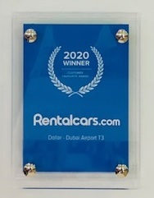
Awards and Achievements
Our services are consistently recognized for their excellence in quality, reliability, and innovation.
Dollar Rent-a-Car has been awarded the Customer-favorite award for the year 2020 consequently for the second year.
Dollar Rent-a-Car has been awarded the 2016 Super-brand accreditation award

Slide 7
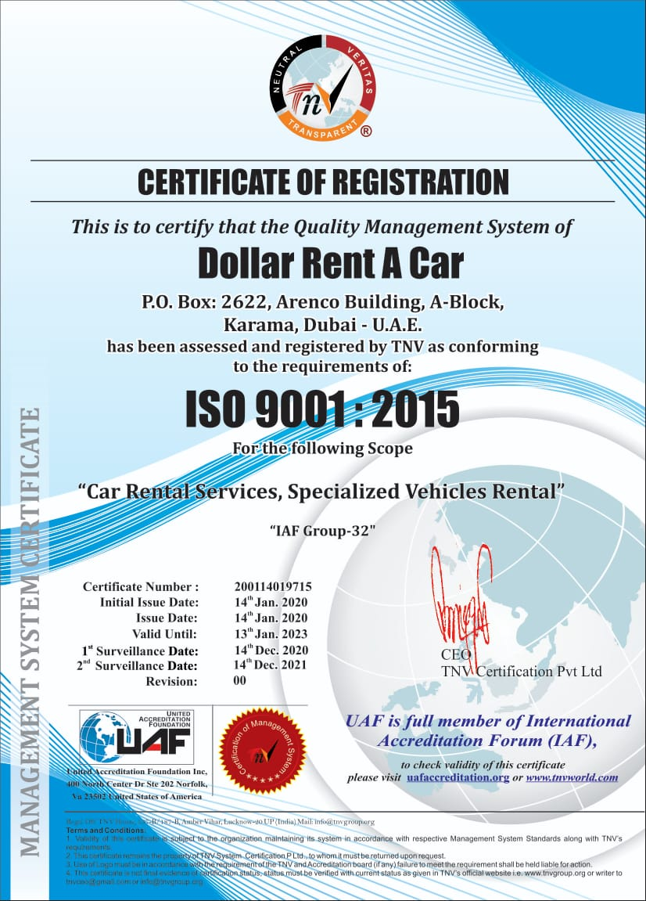
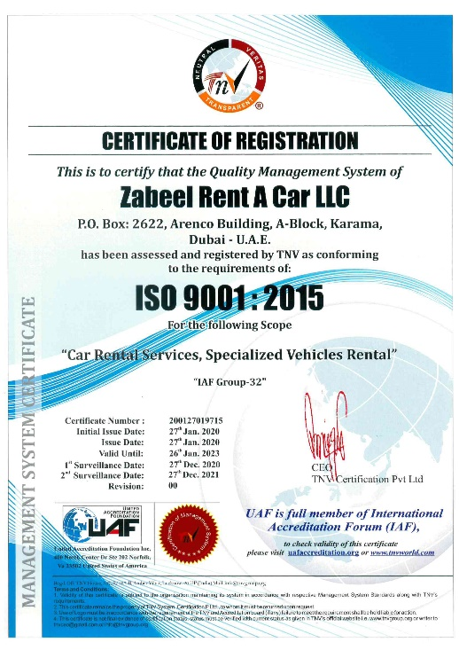
Awards and Achievements
Dollar Rent-a-Car is ISO9001 certified company
This ensures our processes and procedures throughout our entire business are audited to ensure they met the required criteria set by the governing body.

Slide 8




















Clientele Universe

Slide 9

















Our Loyal Companions

Slide 10
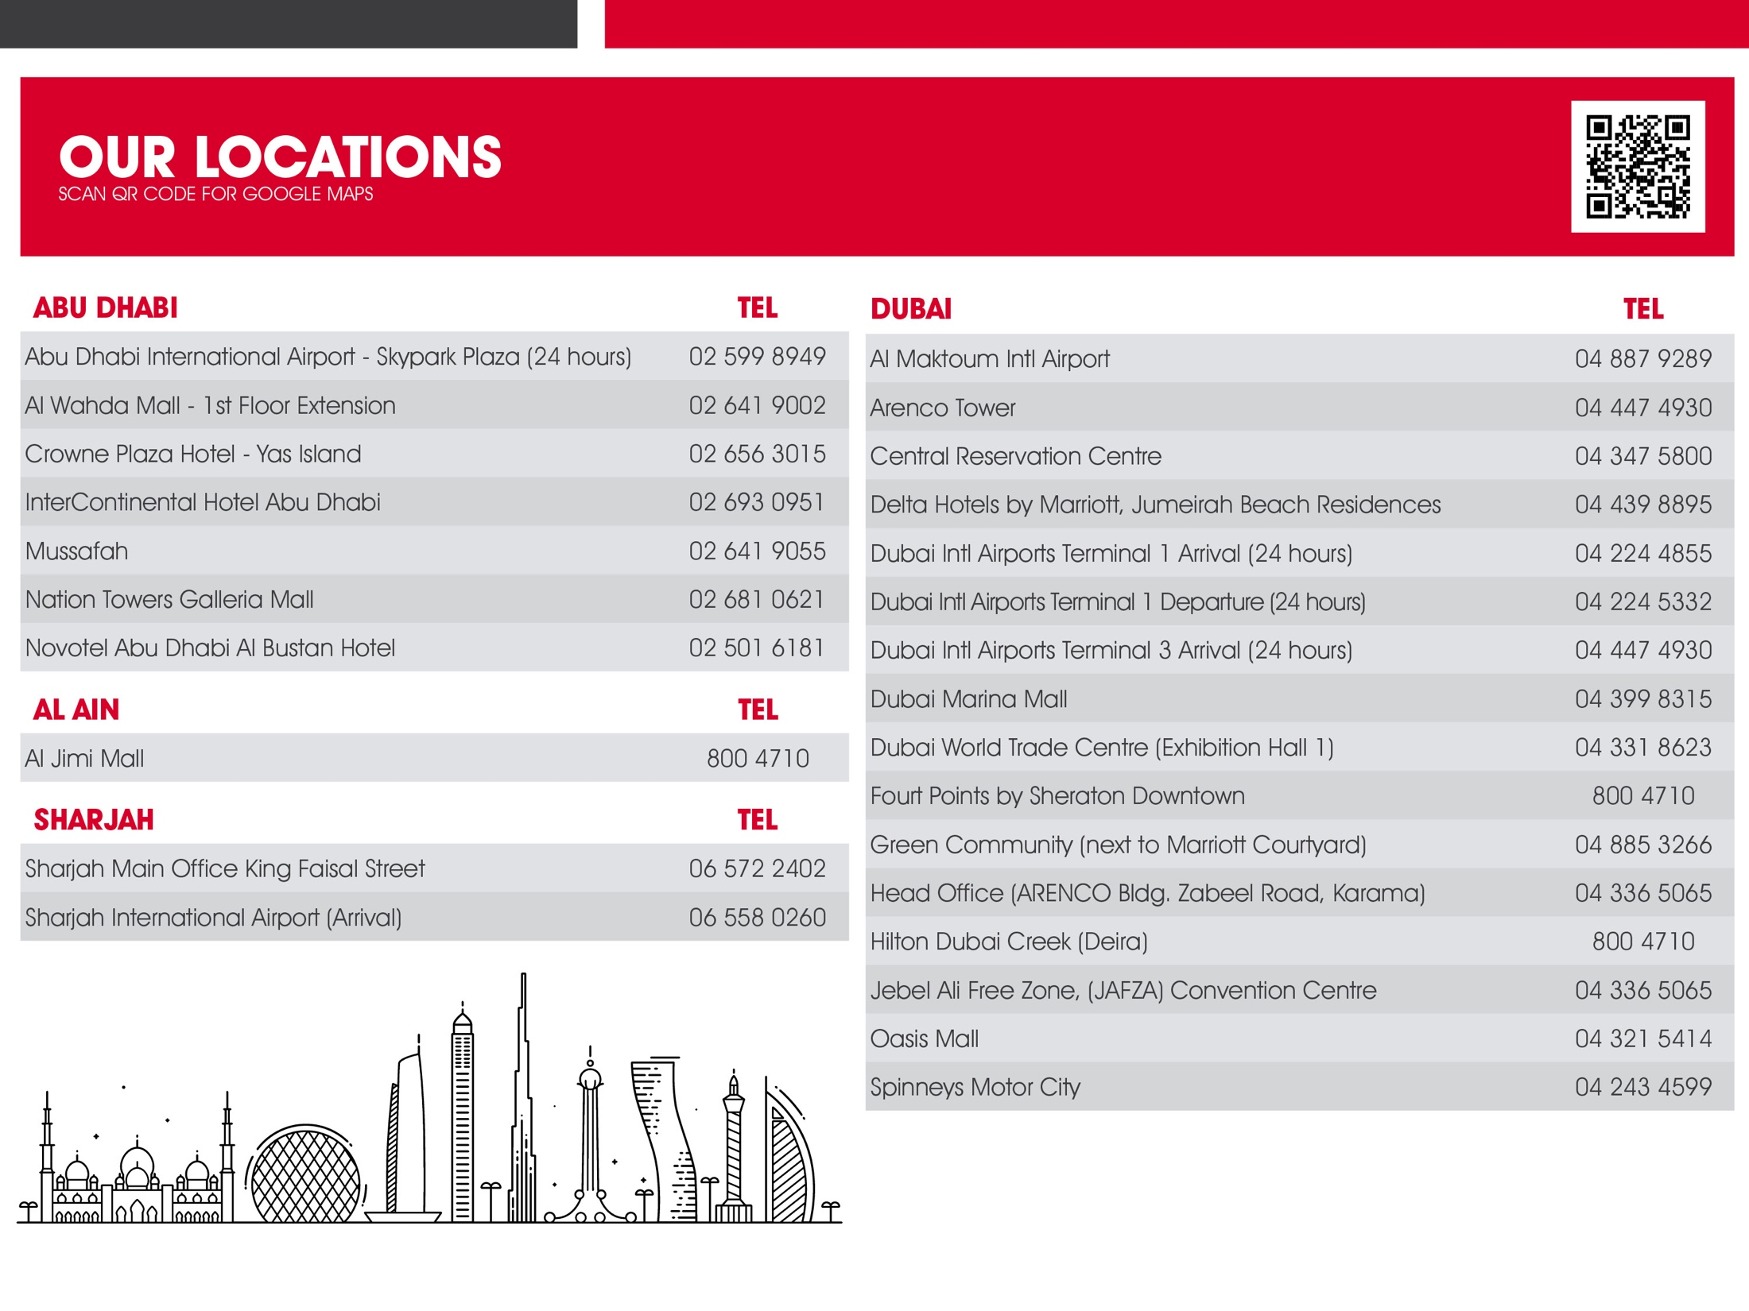

Slide 11

The Leadership which
Made us Great
Marwan Al Mulla – General Manager – UAE & Oman
16 years in the car rental industry and has been the driving force within Dollar Rent-a-Car UAE & Oman for the last 13 years.
Anudeep Raghuthaman – Retail & CS Manager – UAE
13 years experience, with Dollar Rent-a-Car acting as Retail and Customer service Manager. Experience in Retail management, customer experience planning and market analytics. Plays a vital role in the company.

Slide 12
Contact Us
Dollar Rent a Car UAE
PO Box 2622
Dubai, UAE.
T: +971 4 3365065
Toll free 800 4710
makeabooking@dollaruae.ae
customer.care@dollaruae.ae
www.dollaruae.com

